Slide 1

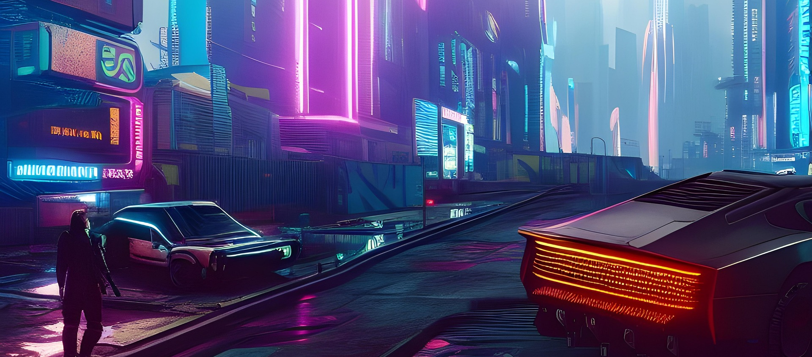

Transitioning To Unreal Engine
(Wellington, 2022)
Samuel Zipperer
Student ID: 013321099
D339: Technical Communication (WGM2)
Notes:
Hello everyone, and thank you for taking the time to join me today. I am Sam Zipperer, and as an indie game studio, we have always been player-obsessed. We are constantly striving to deliver the most engaging, high-quality experiences possible to our community. However, to support higher-fidelity releases and streamline how we build our games, I believe it is time for us to evaluate our current workflow and look ahead. Today, I want to talk to you about why transitioning our development pipeline to a new workflow is warranted. In this presentation, we will discuss making the leap to Unreal Engine, a powerful game development platform from Epic Games that will enable our team to tackle more ambitious titles and take our studio to the next level.

Slide 2
Agenda
In this presentation, we will discuss:
What is Unreal Engine and why should we use it over Unity Game Engine?
The benefits of adopting this technology to our company to our future projects.
Notes:
Before we dive into the technical details, I will briefly review the agenda for today's presentation. First off, we will cover what Unreal Engine is, how it works under the hood, and outline some of its main features that directly apply to our daily workflow. Second, we will discuss the direct benefits of adopting this technology for our company. I will break down exactly how this shift will impact our software engineers, 3D artists, and gameplay designers, and why moving away from our current Unity engine setup will ultimately give us greater creative freedom and financial stability.

Slide 3

What is the Technology (or practice/process)?
What is it? Unreal Engine is a game development platform created by Epic Games that supports the creation of high-fidelity, ambitious titles.
How does it work? The engine operates using C++ combined with a highly versatile visual scripting tool known as Blueprints (Bogner, 2025).
Features of the technology include:
  Industry-leading photorealism featuring next-gen physics, lighting, and visual effects (Mozolevska, 2026).
  Nanite and Lumen rendering capabilities that provide out-of-the-box optimization (Fonarov, 2026).
  Native advanced tools, such as the World Partition system, which handles massive open-world environments effortlessly.
(Garner, 2025)
Notes:
So, what exactly is Unreal Engine? It is a comprehensive game development platform built for massive, hardware-intensive projects, putting industry-leading photorealism right at our fingertips. Until now, we have used the Unity game engine to build our games, an environment that often required us to manually build, script, and optimize foundational rendering systems from scratch. Moving to Unreal represents a major shift in our day-to-day operations, replacing manual hurdles with out-of-the-box automation. From handling complex visual scripting connections to automatically managing memory and asset scaling, Unreal takes over the heavy computational lifting, allowing our team to build faster and larger than before. How does it work? Under the hood, Unreal Engine utilizes the C++ programming language alongside a highly versatile visual scripting tool called Blueprints. While learning a new workspace and coding language can certainly be daunting, Unreal's toolset is specifically designed to accelerate our workflow.Let's take a look at some of the main features. Unreal Engine supports incredibly high-definition graphics, which include next-generation physics, lighting, and visual effects. These capabilities will allow our company to unlock the next level of our evolution. All while dominating cinematic, AAA, and virtual-production work right out of the box. By leveraging the Nanite and Lumen rendering systems, our developers can skip the hours of manual optimization typically required when working in Unity.

Slide 4
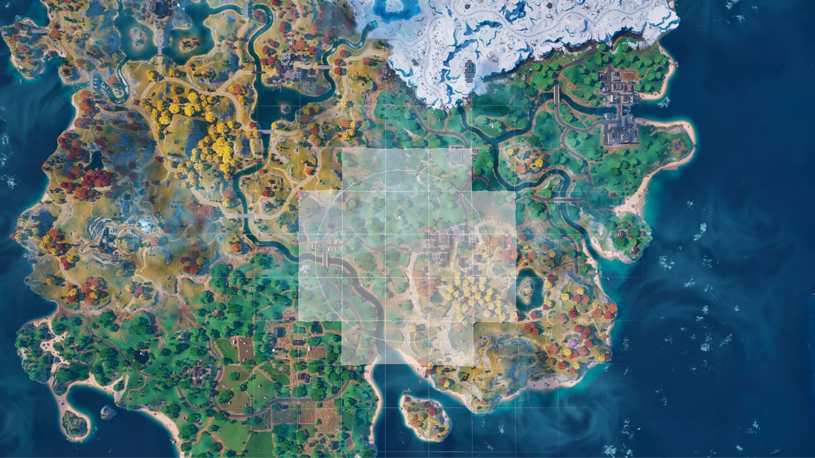
Benefits of the Technology to Our Company
Bridging Design and Development: Unreal's Blueprints visual scripting system allows our artists and designers to actively build and test gameplay logic through an intuitive node-based interface.
Highly Accessible Pricing Model: The engine is completely free to use until a game generates $1 million in revenue, which gives our studio access to premium development tools with zero upfront software costs.
Scalability and Developer Control: Transitioning provides us with unrestricted access to the C++ source code, allowing engineers to modify the engine directly instead of facing expensive enterprise paywalls.
Future-Proofing the Pipeline: Native multiplayer infrastructure and advanced tools reduce our reliance on third-party plugins and external asset stores, clearing technical roadblocks for complex game development.
(Epic Games, n.d.)
Notes:
This leads us to exactly why our studio should fully transition to Unreal Engine for our upcoming projects. Firstly, I want to talk about bridging the gap between design and development. Unreal's Blueprints visual scripting system allows our artists and designers to actively build and test gameplay logic through an intuitive node-based interface, without needing an engineer to hard-code every interaction. Secondly is the highly favorable business model for indie studios like ours. Unreal Engine is completely free to use until a title generates one million dollars in revenue. This means we gain access to industry-leading development tools with zero upfront software costs, which is a massive win for our financial stability. Third, we have to look at scalability and developer control. Comparing Unreal Engine directly to our current Unity workflow reveals stark differences. Building complex systems in Unity, such as expansive open worlds or robust multiplayer networking, often requires our team to rely heavily on third-party plugins or custom architecture. We are not alone in facing this hurdle; the indie studio Pocketpair famously transitioned its massive hit Palworld from Unity to Unreal Engine specifically to handle the game's growing scale and complex multiplayer infrastructure. Finally, Unreal provides unrestricted access to its C++ source code. This allows our engineers to modify the engine itself rather than being locked out by the expensive enterprise paywalls we currently face in Unity. This transparency reduces our dependence on external asset stores and future-proofs our pipeline, clearing away technical roadblocks so our team can build without limits.

Slide 5

Unlock Creative Freedom
Work smarter and iterate faster.
Build truly incredible games.
Deliver the absolute best player experiences. incredible games.
(Image Credit: Microsoft Stock Photo)
Notes:
Making the leap to Unreal Engine gives our development team exactly what we need to work smarter and build truly incredible games. Embracing this transition means unlocking greater creative freedom while keeping our biggest promise as a player-obsessed team: delivering the absolute best, most engaging experiences possible.

Slide 6
References
Wellington, B. (2022, September 30). Dynamic lighting blade runner 2049 [Digital image]. Pixabay. https://pixabay.com/illustrations/dynamic-lighting-blade-runner-2049-7490749/
Garner, J. (2025, May 22). Robot ai generated technology [Digital image]. Pixabay. https://pixabay.com/illustrations/robot-ai-generated-technology-9612727/
Butler, G. (2014, July 10). Battleship engine room historic war [Digital image]. Pixabay. https://pixabay.com/photos/battleship-engine-room-historic-war-389274
Epic Games. (n.d.). World partition in Unreal Engine. Epic Developer Community. Retrieved October 16, 2026, from https://dev.epicgames.com/documentation/unreal-engine/world-partition-in-unreal-engine
Fonarov, O. (2026, July 16). Unity vs Unreal Engine: which to choose. Program-Ace Blog. https://program-ace.com/blog/unity-vs-unreal/
Mozolevska, V. (2026, June 24). Unity vs Unreal Engine: Pros and Cons. Kevuru Games Blog. https://kevurugames.com/blog/unity-vs-unreal-engine-pros-and-cons/

